Slide 1

CREDIT CARD FRAUD DETECTION
Using Machine Learning (Random forest classifier & XGboost)
TEAM- CODEBUSTERS
THEME- CYBERSECURITY

Slide 2

Problem
As technology is drastically growing, we all are shifting to e-commerce, e-pay and so surveys say that 80-90% of the people have shifted to e-payments or online transactions, say Paytm, Gpay or any other random surfed site of clothing or groceries. Some non- secured sites even try to access user’s highly confidential information without their permission. Hackers also got their hands red into it, and can easily hack into the local sites to get the credit card informations, and we never know how much lossy it could be!

Slide 3

What Market requires?
In today’s world, fastest growing market in technical terms, it has become a necessity to at least have a tool or something like that, which will let us know about our transactions.
A TOOL- which will let a user know, whether the transaction he/she made was fraudulent or not.
Not only a particular individual needs that, in-fact big firms, commercial companies, banks and many other organisation has a requirement of it.

Slide 4


Problem in today’s industry
There is a gap between the users and the highly secured network of transaction channels.
There are many Hackers all around, smartly they just hack into the local sites and steal the user’s credential. There are many fraud websites as well, which do the same thing.
We all must have gone through some space of time where without any reason we get some random otps.
And similarly, there are many different types of technique which they use, and user is unaware of that.
Today, it is a very common practice, to steal the credentials and make money!
So, this gap between a secured channel and the user is not yet built completely.

Slide 5

Magic Tool:
Solution
We are using Machine learning techniques and Algorithms to train a model, which will help the user to identify whether a particular transaction was fraudulent or not based on some regress patterns.
Also, we have taken the help of AWS (amazon web services), to deploy the trained model.
The deployed model can be used as a tool by the end users.

Slide 6

Exploratory Data Analysis
The dataset chosen is highly unbalanced with only 0.0172% fraudulent transactions. Hence, we analyse the data to obtain better regress patterns.
STEP 1 -
Presence of any null values and Skewness of features.
STEP 2 -
Correlations between the features and the class of the transaction (fraud or not).
STEP 3 -
Feature scaling is done to optimise model performance.
STEP 4 -
The dataset is split into X and y where y is the ‘Class’ (0 - non - fraud, 1 - fraud) column and X contains the rest of the dataset.
STEP 5 -
X and y are further split into train, test and cross validation sets in suitable proportions.

Slide 7
Training and testing the model
STEP 1 -
Spot-Checking technique is applied to select the best classification algorithm.
STEP 2 -
Using the cross validation results, the algorithms which give the best accuracy are found to be Random Forest classification and XGBoost. So, we proceed to train our model with these algorithms.
RF Classifier is fit to the training set and the resulting object is used to make predictions on the test set. Similarly, XGBoost Classifier is fit and predictions are made.
STEP 3 -
The test set accuracies of RF and XGBoost are found. It is observed that, XGBoost has a slight edge over RF and hence, we use XGBoost Classifier to make our model predictions in deployment.
STEP 4 -

Slide 8
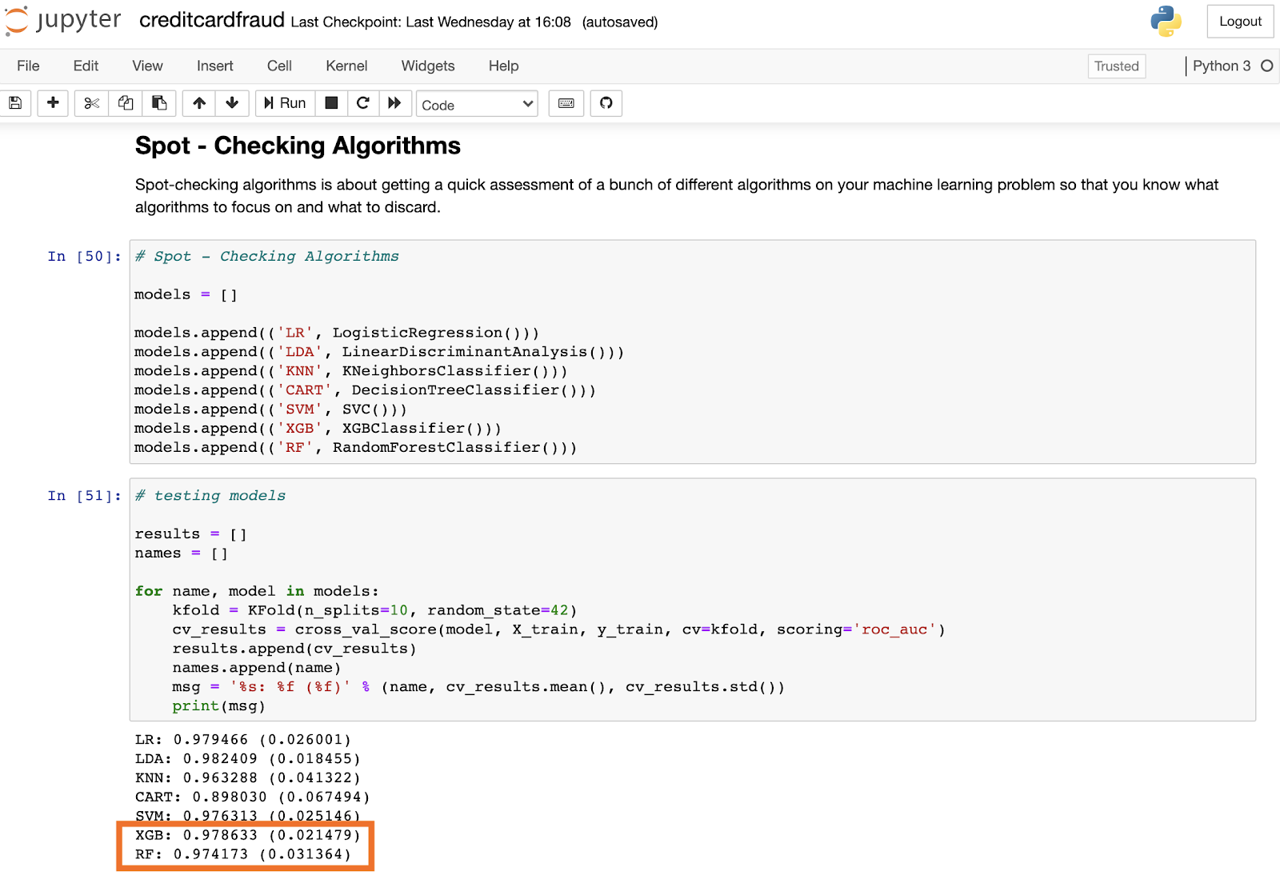
Random forest and XGboost give the highest accuracy

Slide 9
Deploying the model
STEP 1 -
The trained and tested model, using XGBoost, is deployed using Flask framework and AWS.
STEP 2 -
A template html file is made to take the user inputs and give them the predicted results.
STEP 3 -
Using the flask framework, we create an API using which we create user interface.
The inputs taken are modified and feeded to the trained XGBoost model.
STEP 4-
The model predicts whether the transaction is fraudulent or not, and accordingly informs the user (this works on a local IP address and is accessible by only us).
STEP 5 -
STEP 6 -
Hence, to make our model accessible to all, the API created is deployed using AWS.

Slide 10



A step-wise briefing of the FraudDetectorTool
STEP 1 -
User will have to upload the details of the transaction, which he/she wants to check.
STEP 2 -
As soon as user clicks the PREDICT button,
What happens in background is, it will redirect to the trained model that we have.
Input entered by the user, will be converted into desired form and fed to the ML model.
STEP 3 -
Now, on the screen USER will get the result as if the transaction was Fraudulent or not.

Slide 11
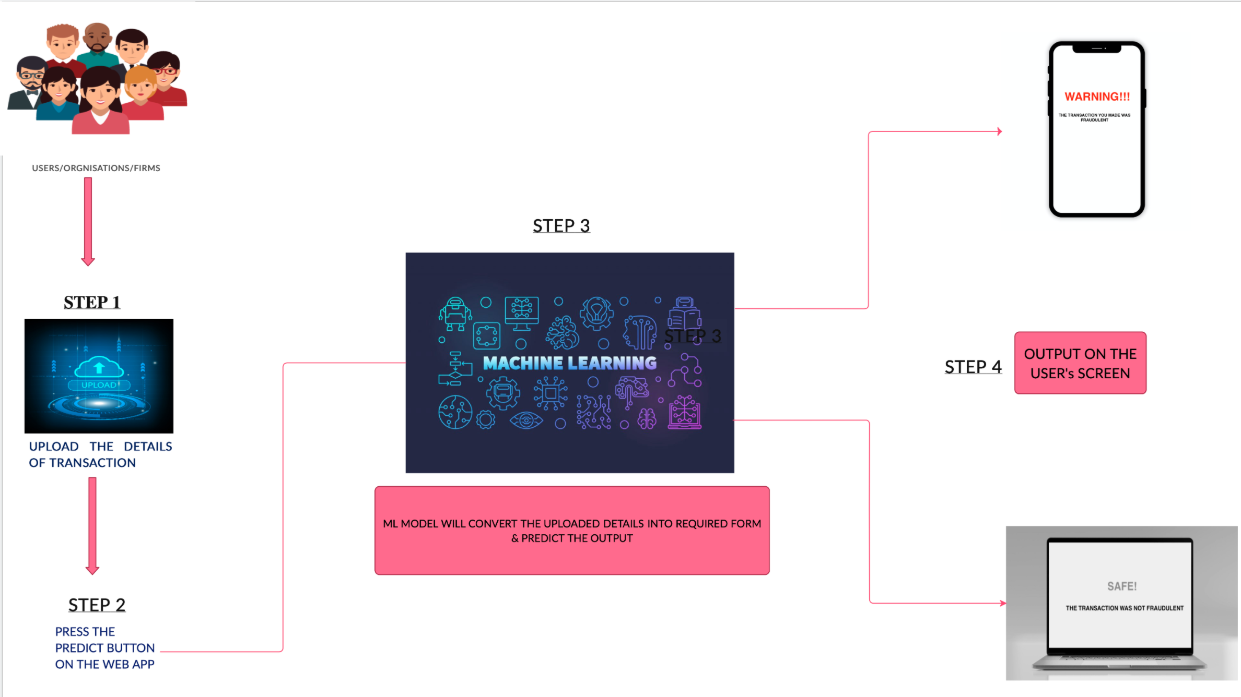
WORK FLOW

Slide 12

A tool for Market- Stakeholders & Firms
The major problem nowadays is the misusing of the data, the cyber crimes that are tremendously increasing.
So, our tool in the current situation would be of great use and will fill that gap and provide the useful.
Every company from small organization to a big one, wants to provide safe services to the customers. Say it bank or any other e-commerce site.
Our Tool will help detecting the frauds and that would be in return can prevent a big loss to the users

Slide 13


Future Scope
It is a matter of fact that, the user does not know if a fraudulent transaction is being performed using his credit card. And hence, he himself cannot give the transaction details to check its authenticity.
A secure framework can be built, using which the details regarding the transaction, are transferred to our deployed model. After encoding these confidential details using PCA, they are fed to our model to make predictions.
If the transaction is predicted to be fraudulent, the owner of the credit card will be alerted, thereby, minimising the chances of frauds.

Slide 14
Future Scope
A secure app can be built for the purpose.
The credit card details of the user are integrated with the app. Whenever a transaction is done with the card, features are encoded using PCA, the app redirects to the model (cloud), checks the authenticity of the transaction and alerts the user back.
Encoding the confidential information using PCA, preserves privacy of user data.
Data privacy can also be ensured by the use of Federated learning. That is, all the user transaction data are not combined anywhere but still all the users collaboratively share our prediction model.

Slide 15
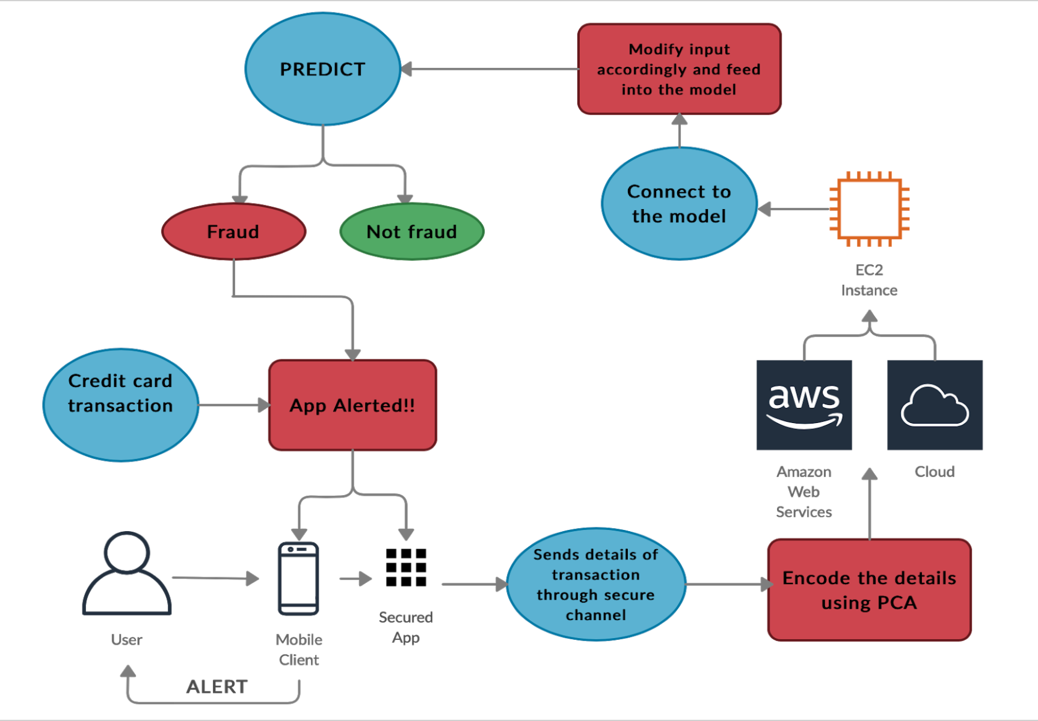
Future scope

Slide 16
HOW LONG CAN IT SUSTAIN IN THE MARKET?
When it comes to any Machine Learning model, it always gets better and more better as we use it time and again.
As the tool will be used by the users, it will get more trained on the different datasets provided by them and the predictability of the model will increase.
So better and accurate results will be predicted by the model.
The model can learn more from the prediction results on user data and update itself accordingly (Incremental learning).

Slide 17

Implementation of the FraudDetectorTool
Deployed the website for the end users (using AWS ec2 instance) and so it is secured at virtual amazon server.
LINK TO WEB PAGE
Jupyter notebook for ML model training-testing.
GitHub LINK to the whole code and implementation including the briefed ppt-

Slide 18



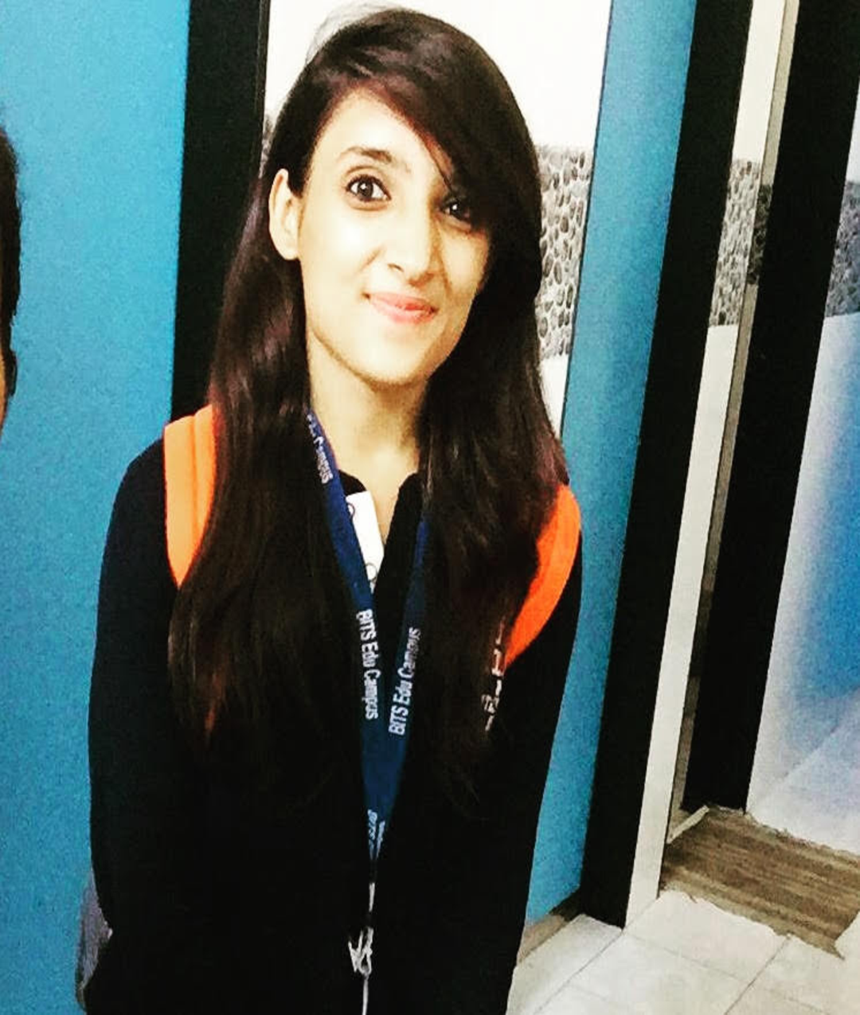
OUR TEAM
MEDHA TIWARI
Computer science Engineering
(3rd year)
PALAKUR ESHWITHA SAI
Mathematics & Computing
(3rd year)
THANK YOU!

